Slide 1
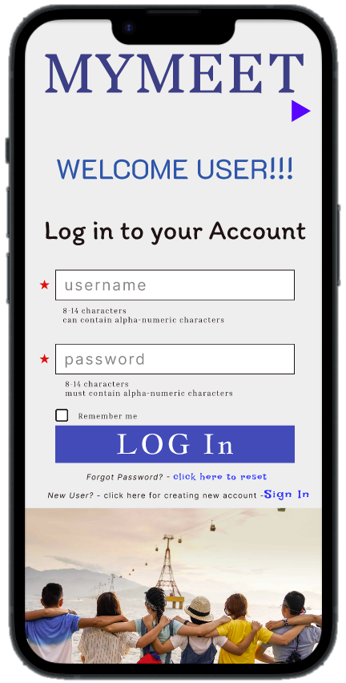
­­‘MyMeet’ PROJECT
Planning to take a break with your busy schedule and spend time with friends?
Wondering to connect with whom to meet? You have come to the perfect place.
MyMeet will help you to keep connected with friends easily in just 3 steps.
- Open Account & Create Friends
- Create a Note, Add Event details
- Connect with people and enjoy

Slide 2

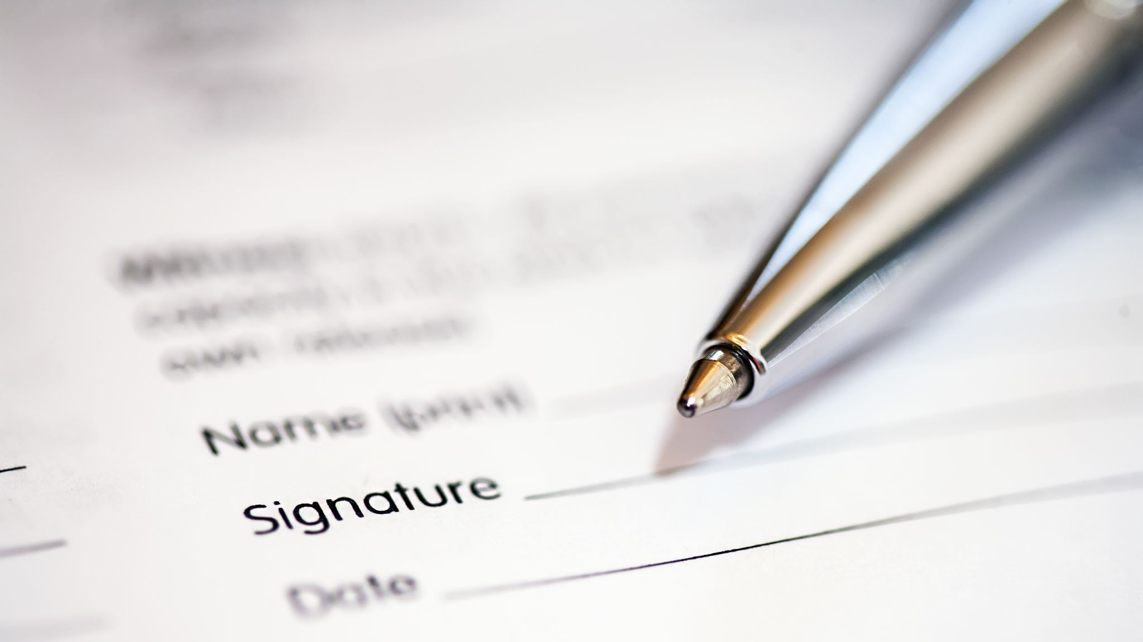
SUMMARY
MyMeet application makes users’ life happy catching up with their nearer ones. Users can publish events in the form of short notes with location and time, and then apply filter to these notes by radius and visibility. Other users can then receive these notes based on their own location and based on the visibility restriction. User can also comment on the notes visible to them. Users can also delete notes as well as comments.

Slide 3

MyMeet
Our Mission-Vision
MyMeet is here to bring your life again in real zone. Get notified & meet your family, friends, relatives who are coming at a place near your house, workplace, or any other location, at a notified destination with no barriers. We are here for you to automatically set up your fun time with those who are near to you. No need to call - No sharing live location with anyone – Just type a text note and select a location and time of your future presence, your friends/public will get notified in a sec based on your visibility-restriction. Comment your friend’s note and catch them at their event.

Slide 4
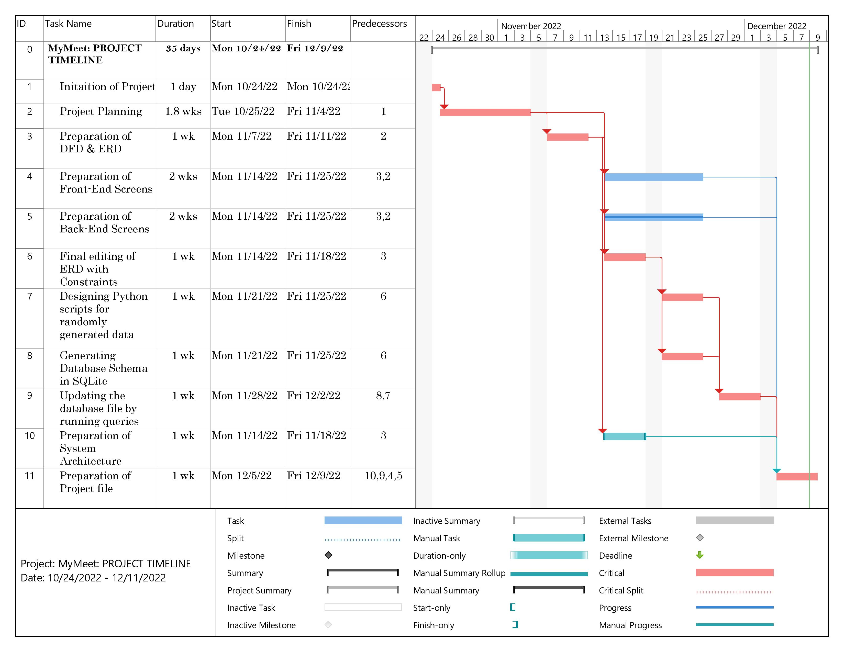
GANTT CHART

Slide 5
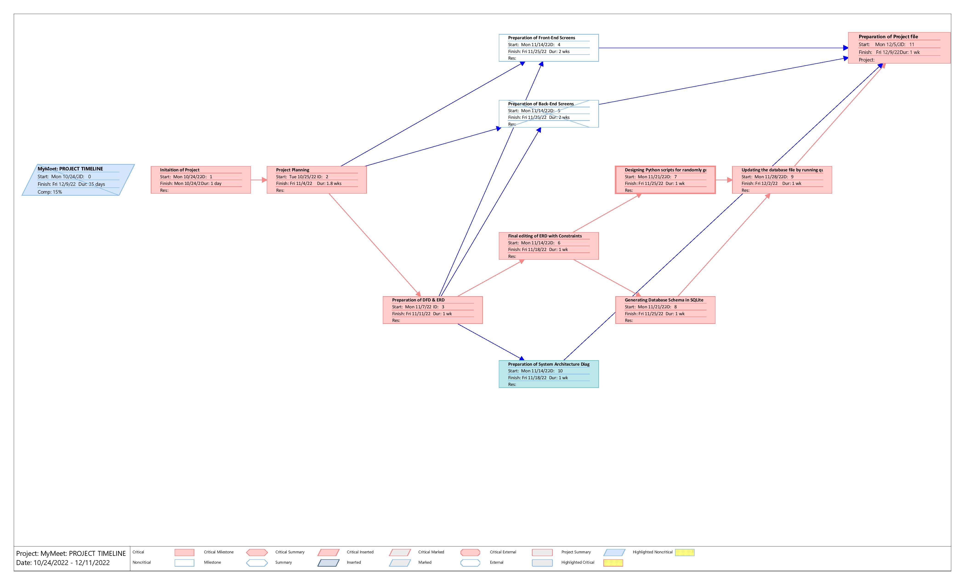
Activity Network Diagram

Slide 6
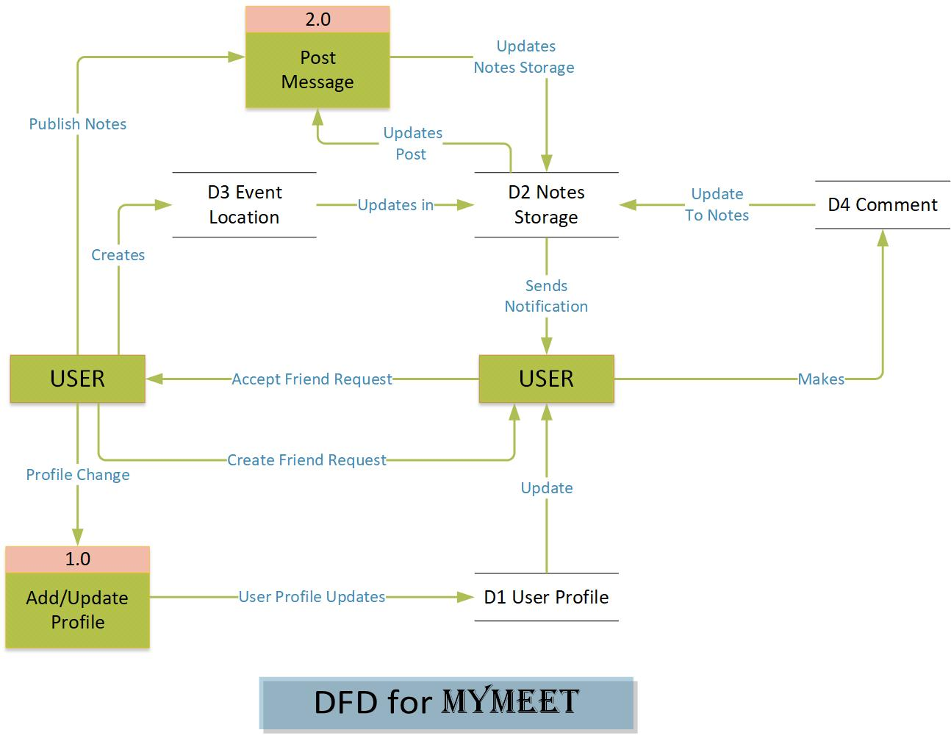
DATA FLOW DIAGRAM
https://lucid.app/lucidchart/057a3d85-e29b-4c28-bfda-a27d443d84b9/edit?viewport_loc=-401%2C110%2C2519%2C1149%2C0DjlVPRn9anX7&invitationId=inv_47b1c330-b5ee-4395-9b45-6dbafa783b42

Slide 7
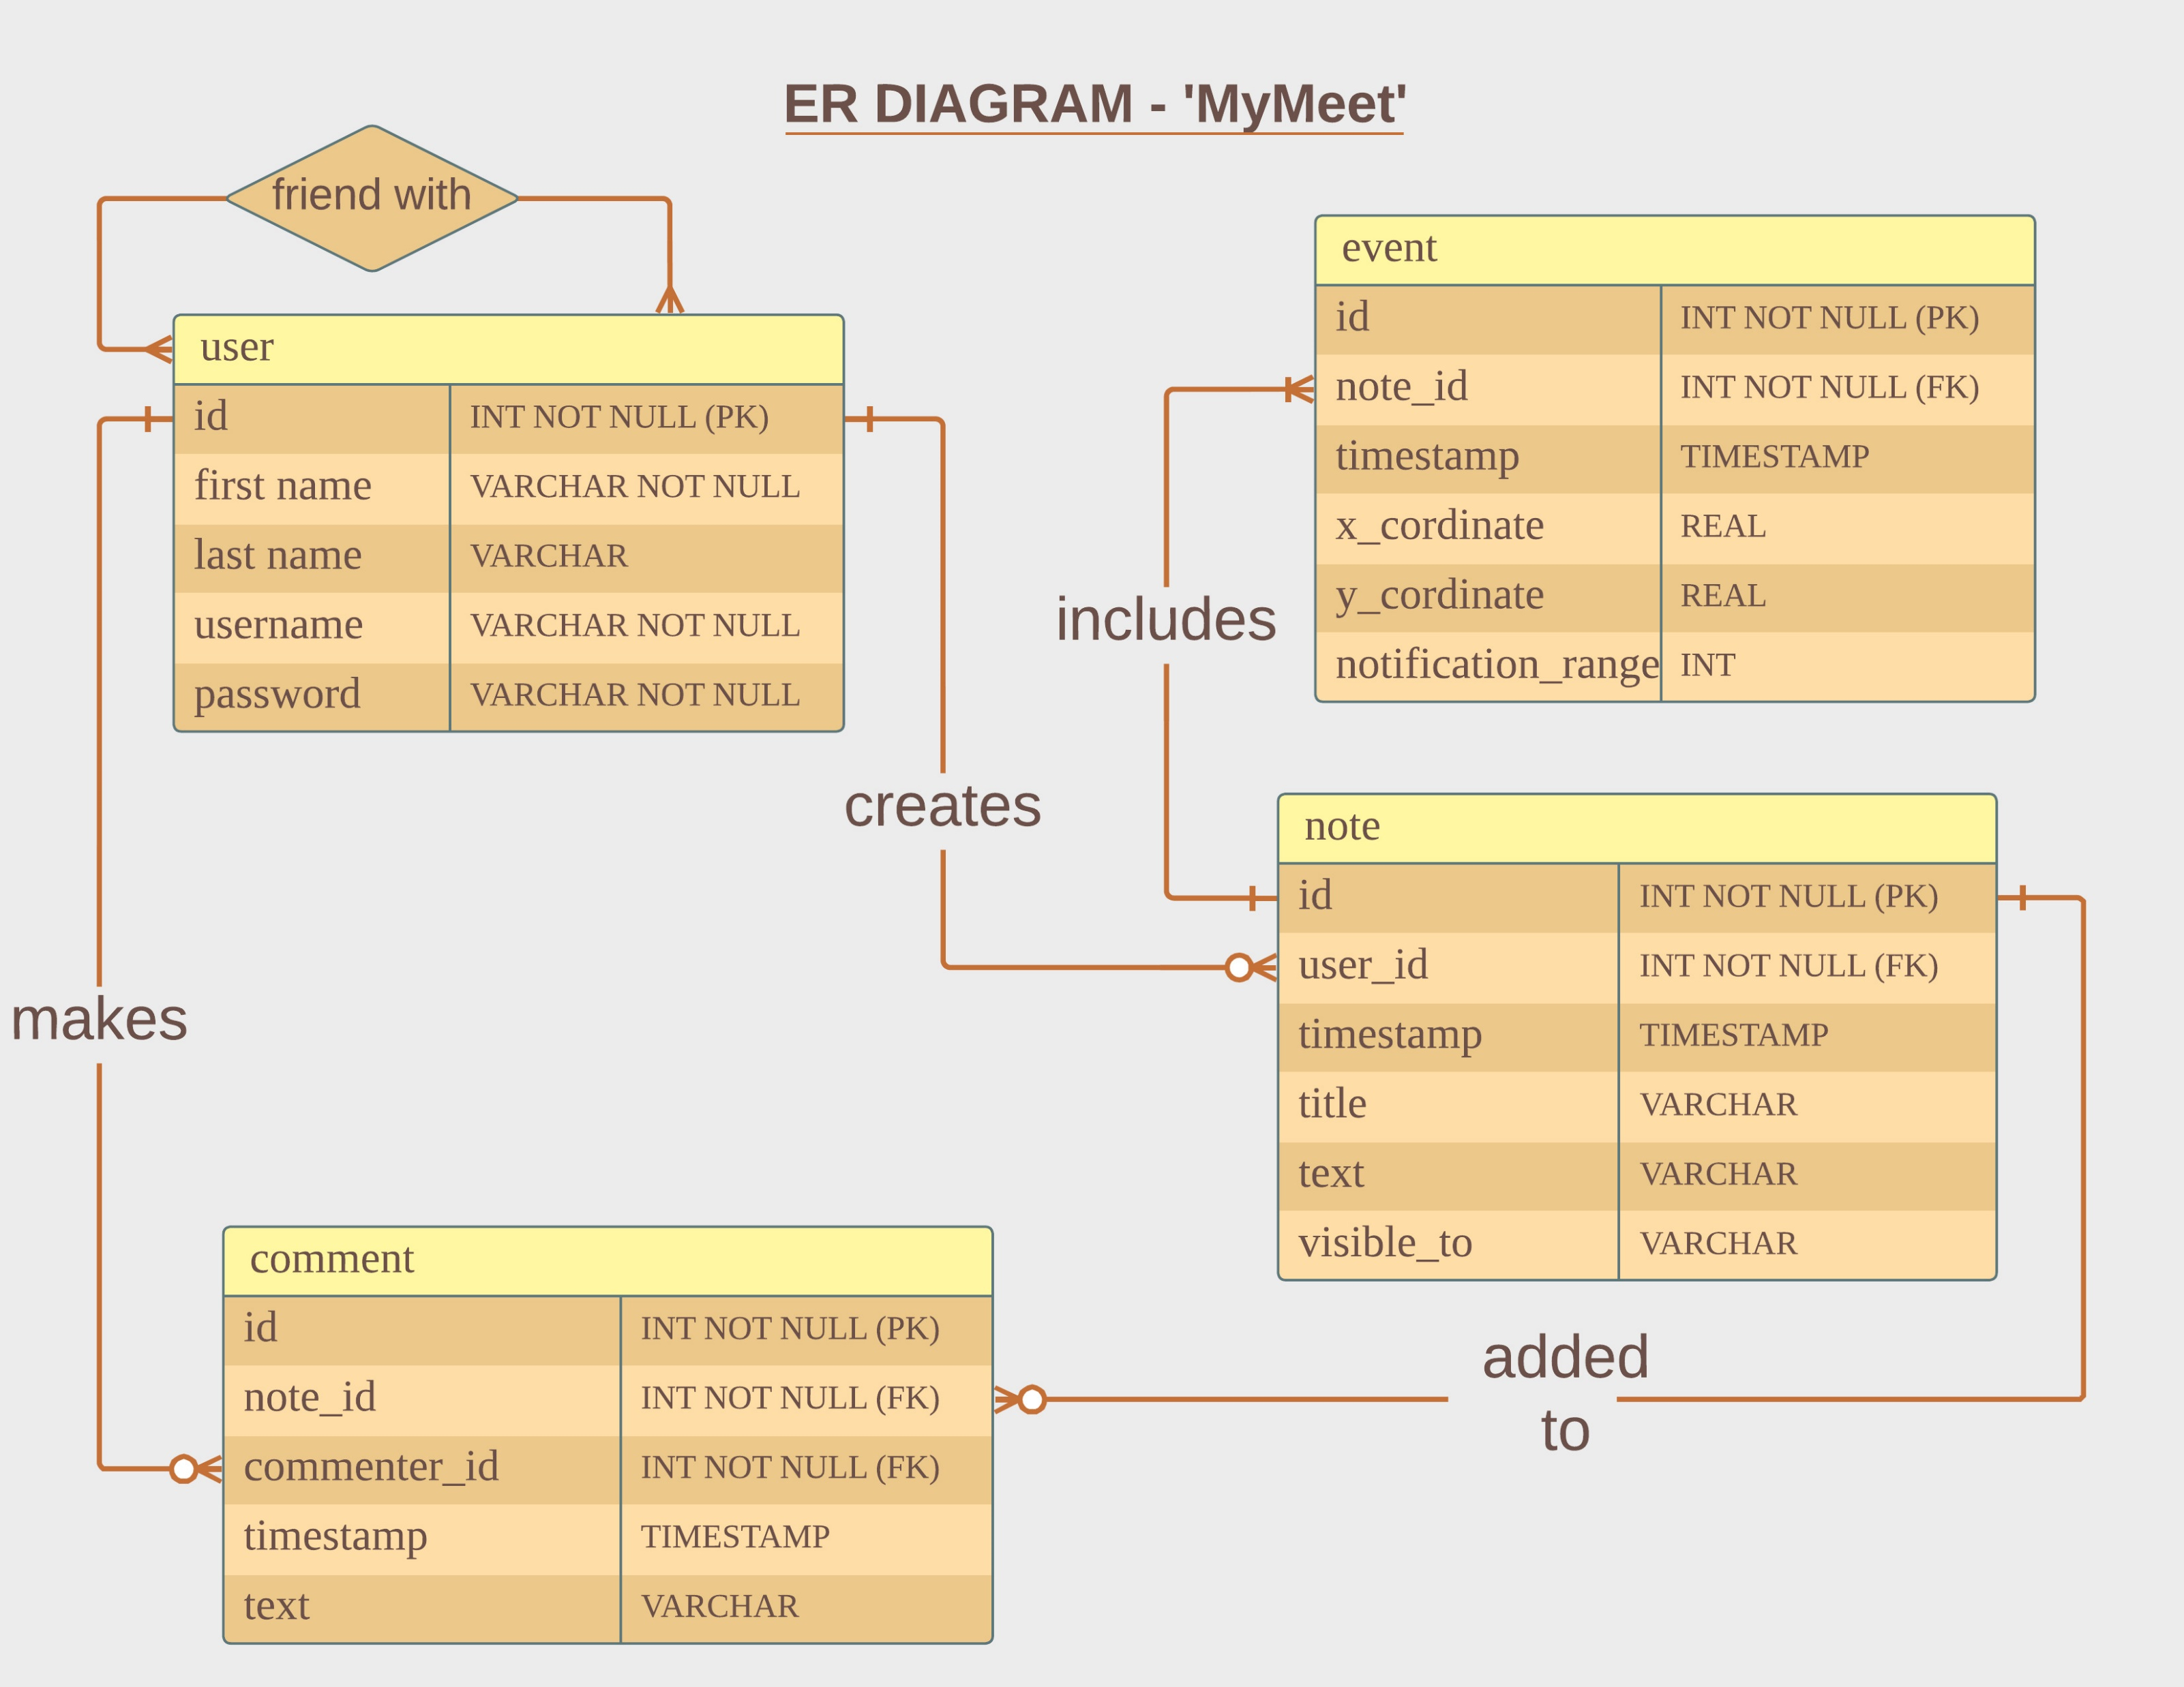
ENTITY-RELATIONSHIP DIAGRAM
https://lucid.app/lucidchart/215b9bfc-0766-43c5-8608-348fa2107b91/edit?viewport_loc=24%2C-37%2C2645%2C1403%2C0_0&invitationId=inv_d9d2572e-e0ff-4595-9fa1-a69c34f5ab45

Slide 8
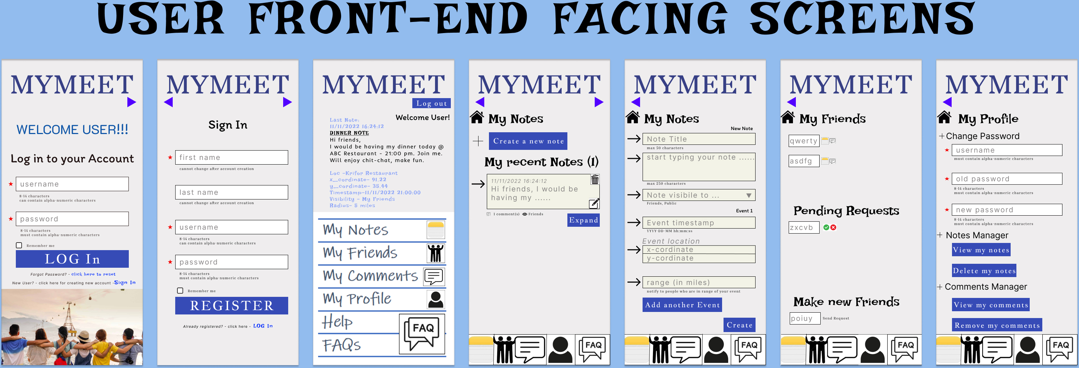
USER-FLOW SCREENS

Slide 9
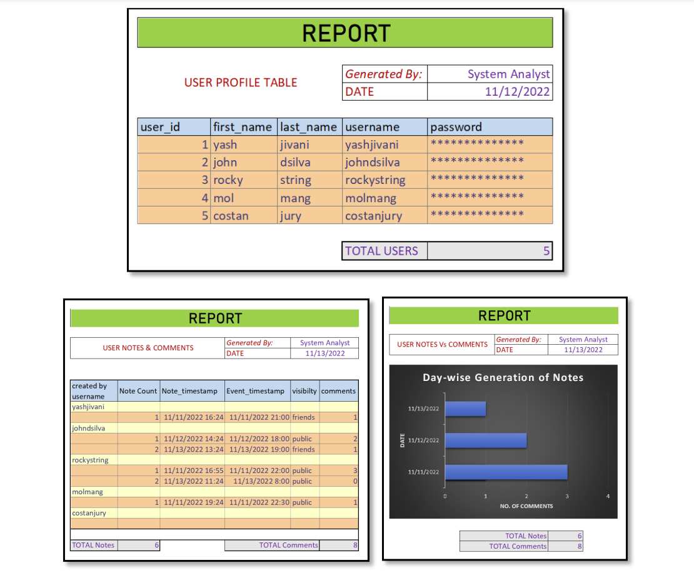
BACK-END SCREENS

Slide 10

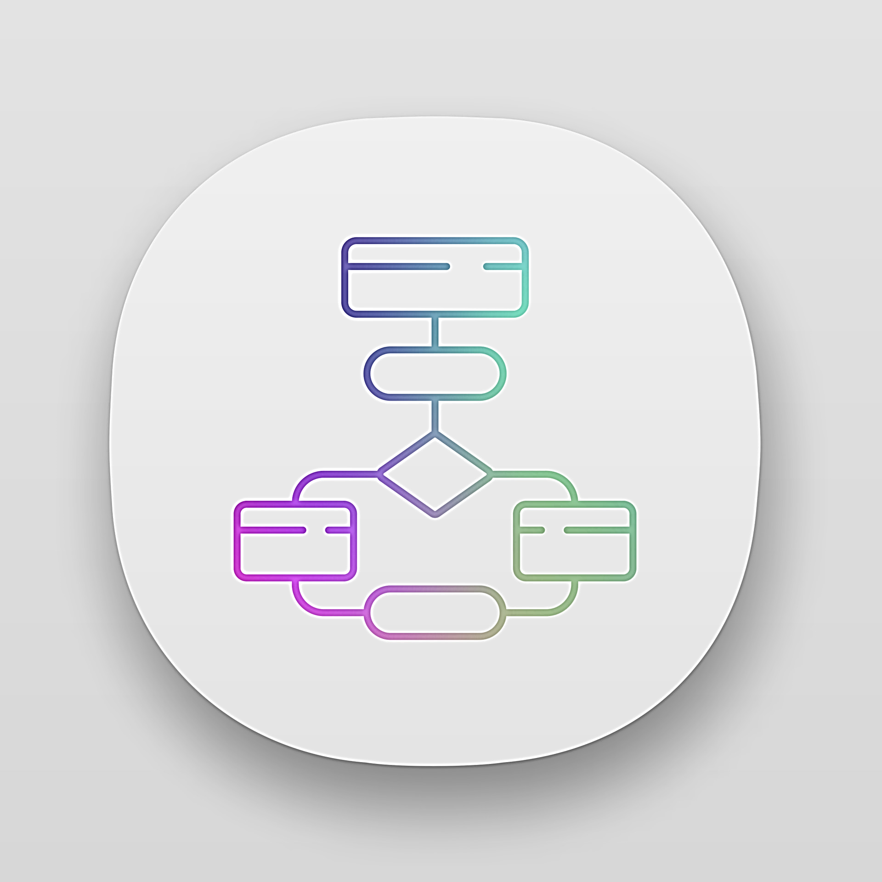




User interaction
App Logic
Create Notes
Request
SERVER
Display Content
Response
System
Database(SQL)
FRONT-END
BACK-END
SYSTEM ARCHITECTURE DIAGRAM
Source: https://litslink.com/blog/web-application-architecture

Slide 11


Compliance & Regulations
The “Least Privilege” philosophy calls for users and applications to have only the minimal privileges they actually require to function properly
User Credentials are not used at any point expect for login purposes
Data Retention Policy
Users’ log data is kept in system for 1 day in back-end data base system for analysts
Comments, notes & events data is deleted from the database when users prompt to delete

Slide 12
Create Map feature to easily navigate users for selection of event location
1
Create Comment feature for each event posted by the user
2
Create Chat feature for users to chat with others personally
3
Add new functionality of storing user’s location and timestamp in the database and deleting using triggers
4
Add new filter tags based on location, comments, schedule, event start and end time .
5
Add comment tags like – will visit/ not able to visit, etc in comment table
6
Make data input in the system to flow in natural way.
7
Increase data set to analyze the trends of users in Data visualization software
8
PROJECT RECOMMENDATIONS

Slide 13
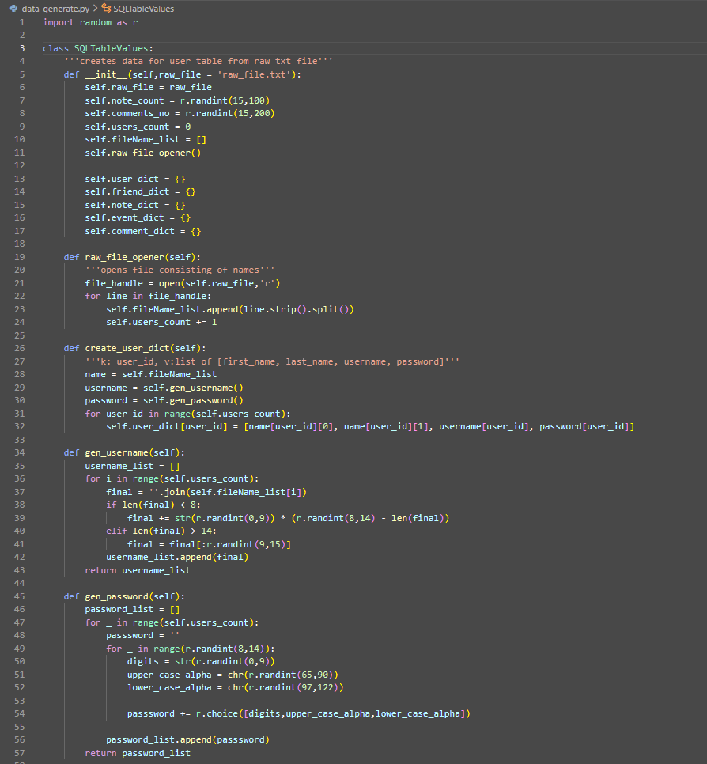
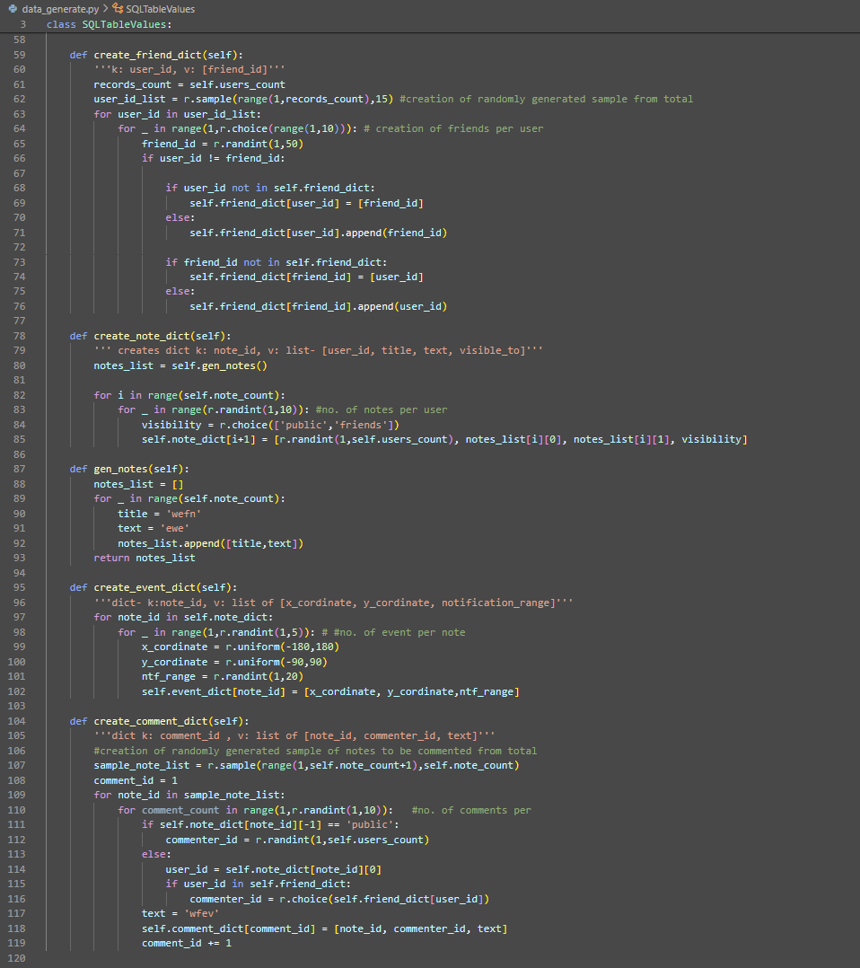
APPENDIX
- Generation of Random Data in ‘SQLTableValues’ object

Slide 14
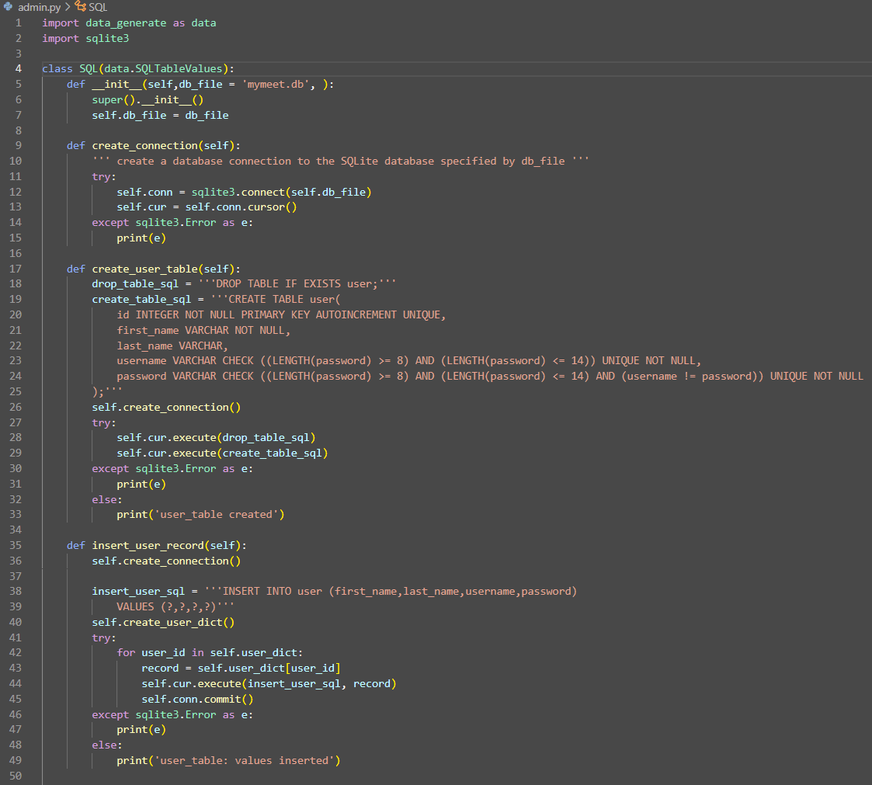
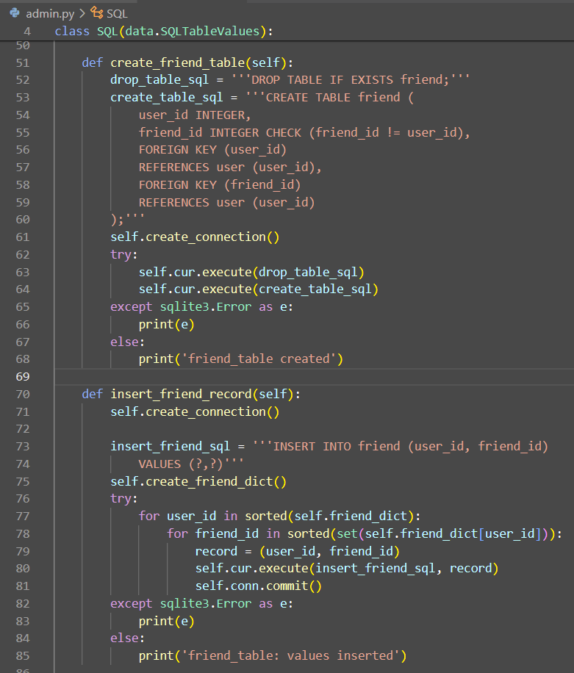
APPENDIX
- ‘SQL’ object inheritence with ‘SQLTableValues’ object

Slide 15
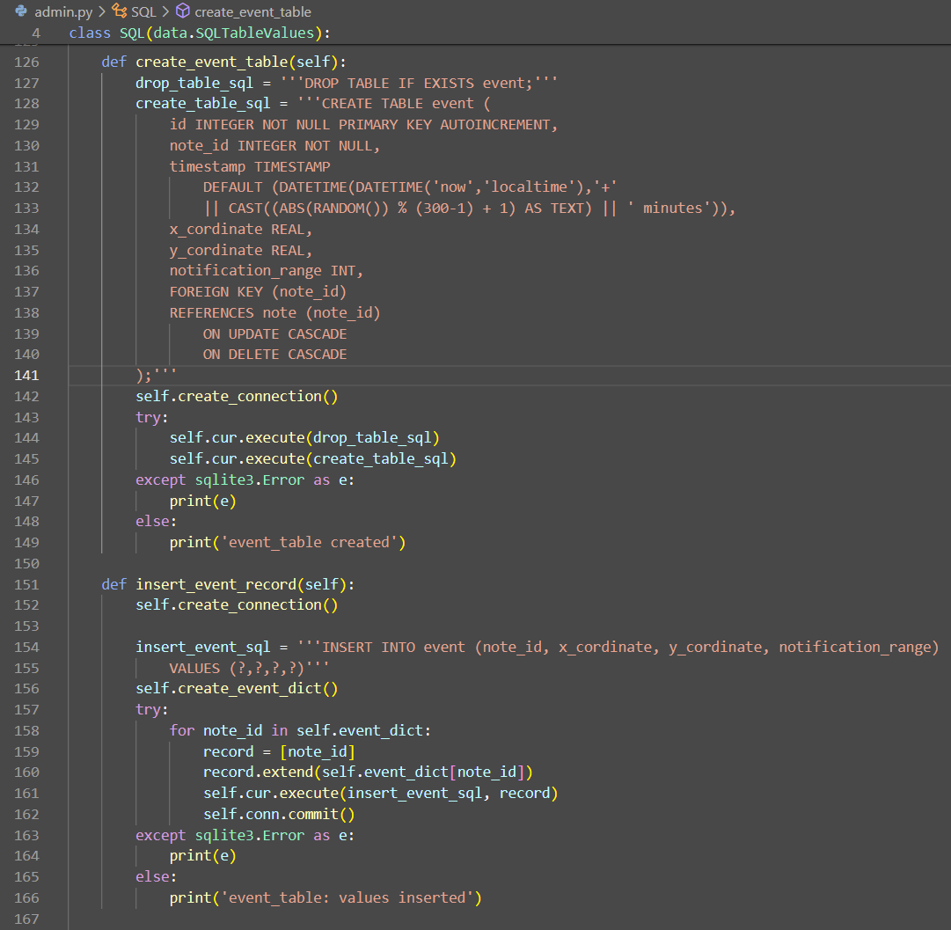
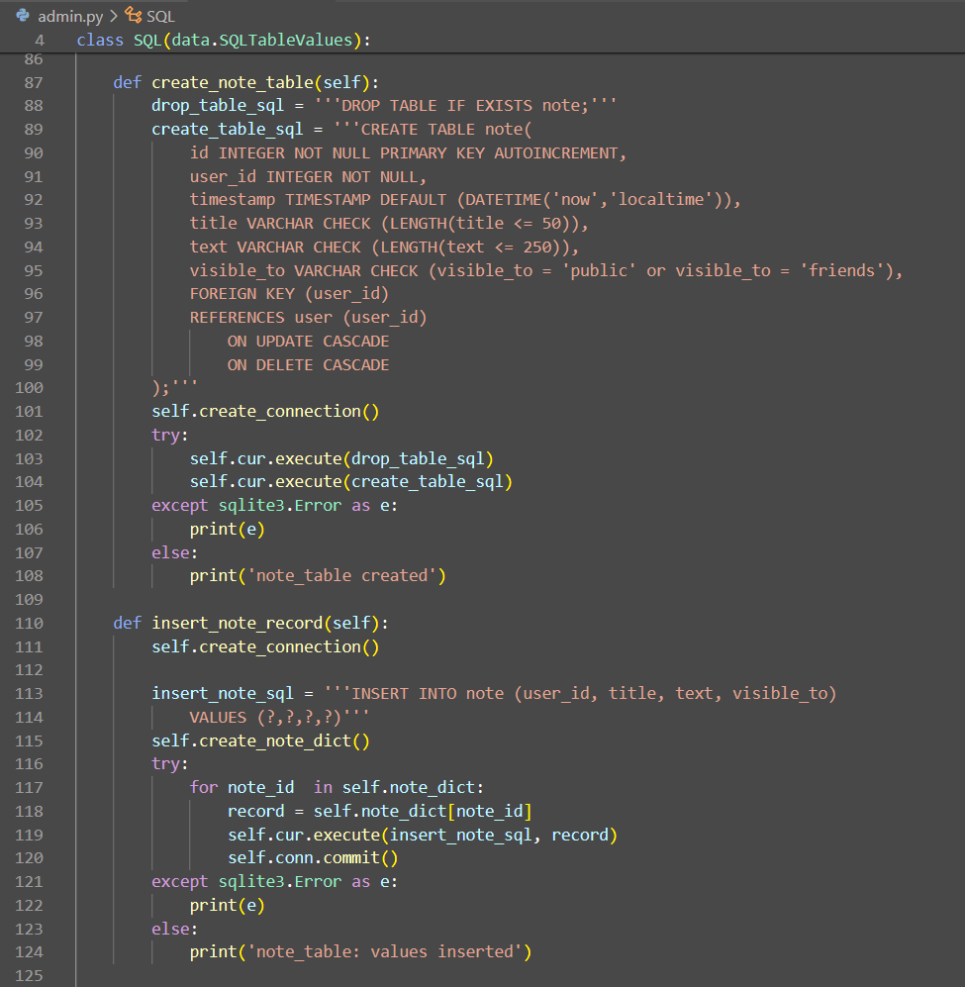
APPENDIX
- ‘SQL’ object inheritence with ‘SQLTableValues’ object

Slide 16
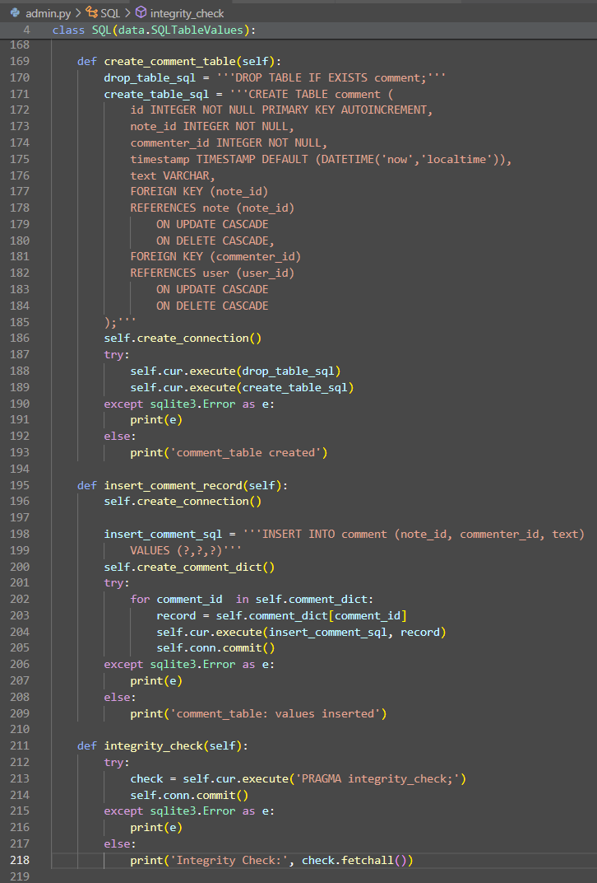
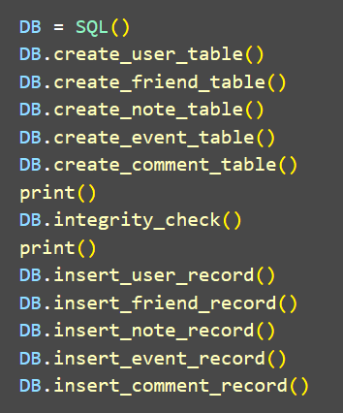
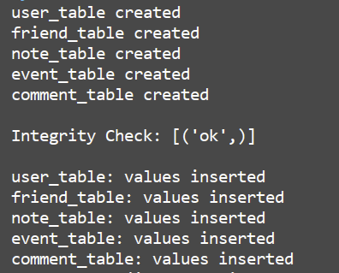
APPENDIX
- ‘SQL’ object inheritence with ‘SQLTableValues’ object
Generation of Database File using SQL object

Slide 17
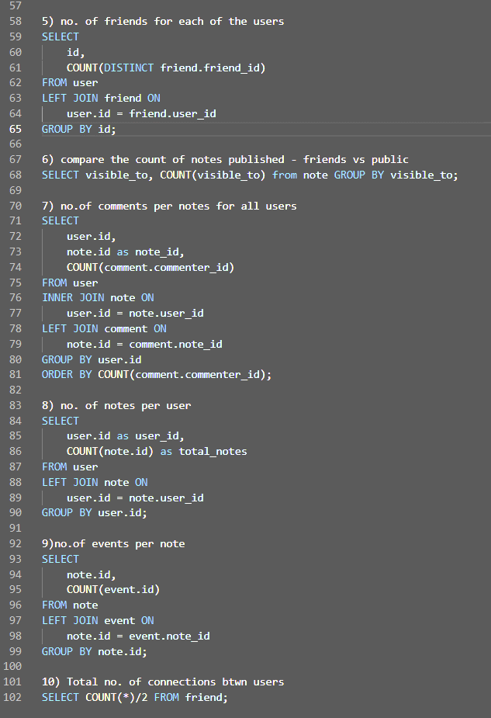
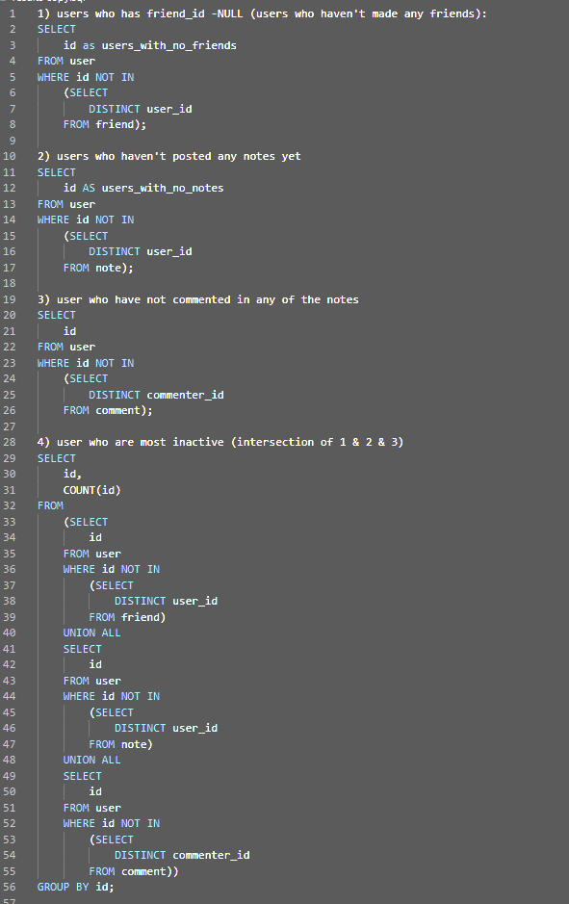
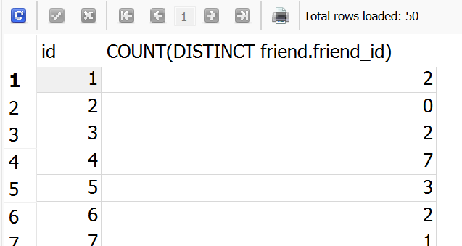
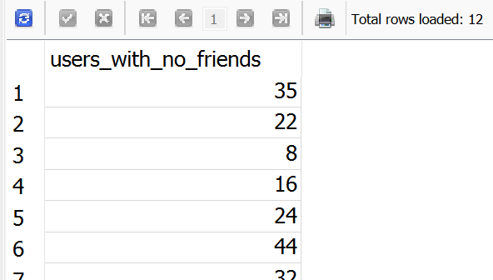
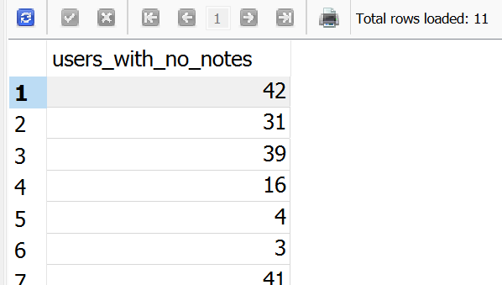
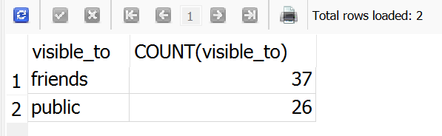
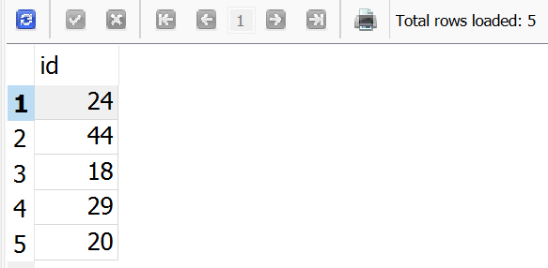
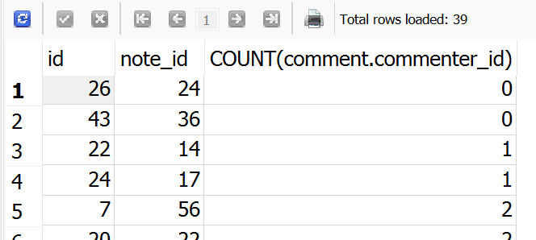
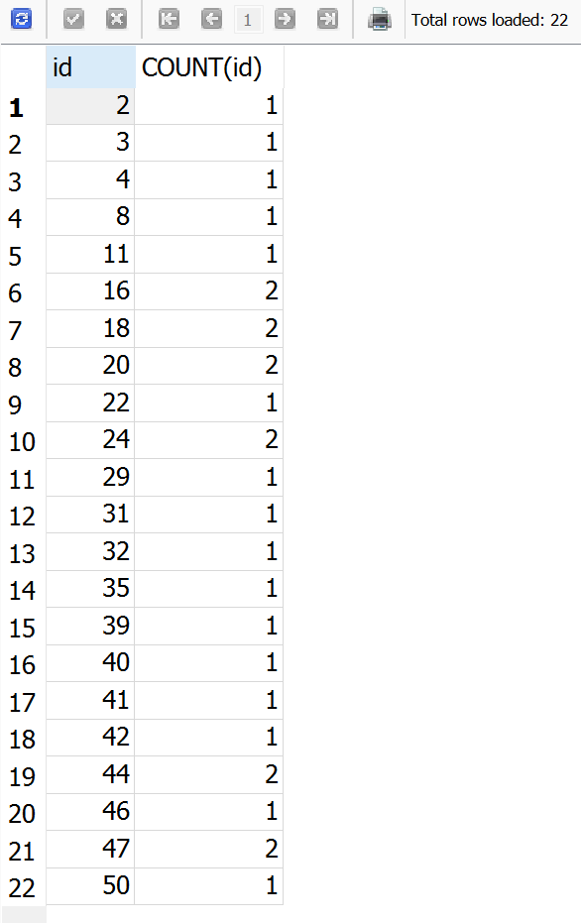
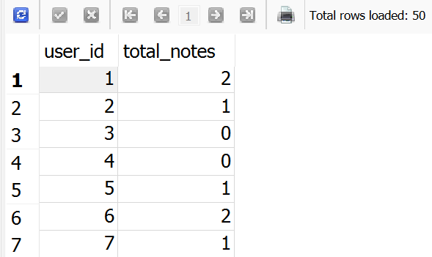
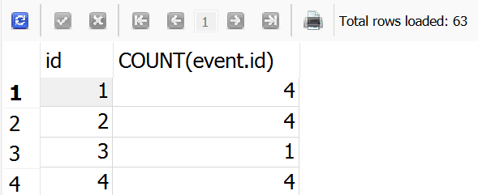
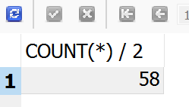
APPENDIX
- SQLite queries

Slide 18
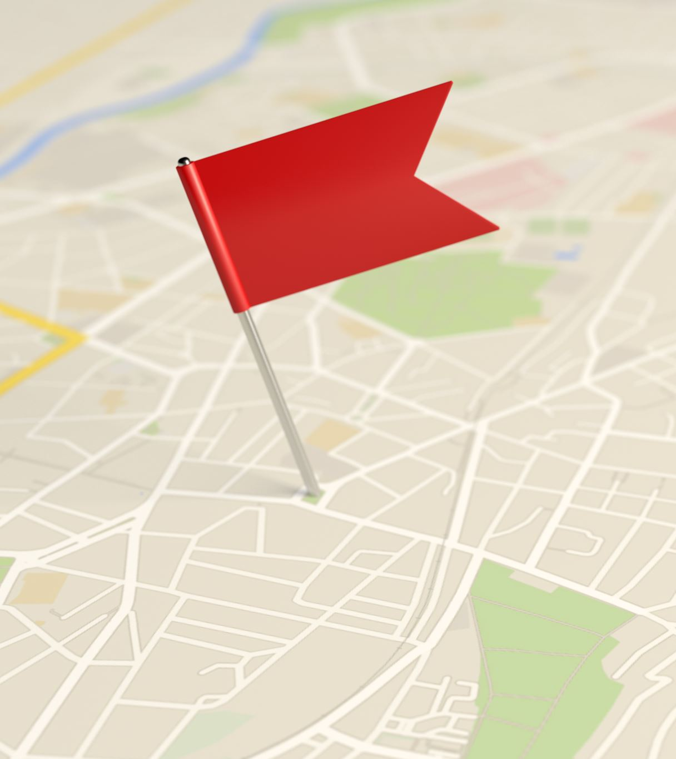
REFERENCES
https://www.iconfinder.com/
https://litslink.com/blog/web-application-architecture

